Slide 1
Strategizing and Improvement
Jackeline Martinez
COO- Baker Product
Ismael Covarrubias
Vice President – Bead Product
Colorado Technical University
MGMT 655
Professor Smith
July 24, 2019

Slide 2
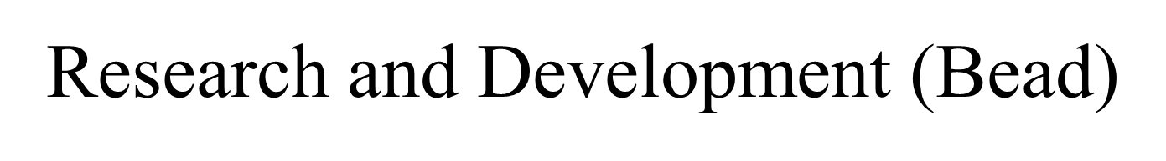
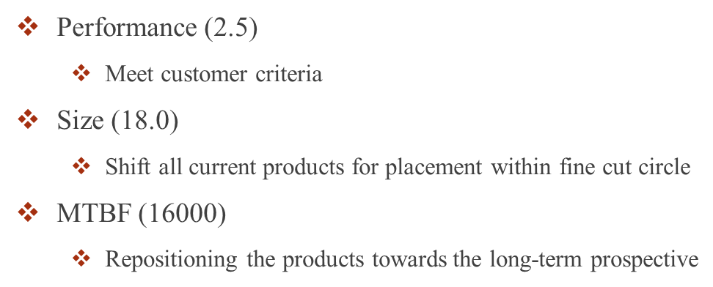
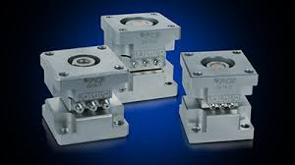
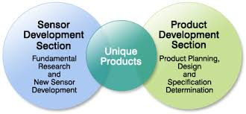
Notes:
R&D
I made my decisions for R&D based off my customer buying criteria. The low-end market segment (Bead) concentrates more on price than any other buying criteria. The ideal position for Bead is only 16% importance. I changed performance to 2.5, size to 18.0, and MTBF to 16000. The low-end customer base prefers sensors with slower performance and larger in size. I made these decisions to increase performance and reduce size as much as you can while still meeting customer needs.

Slide 3
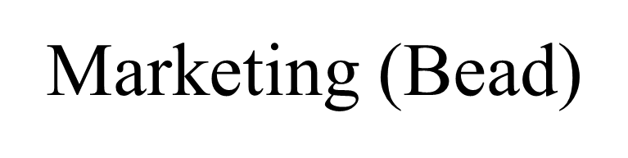

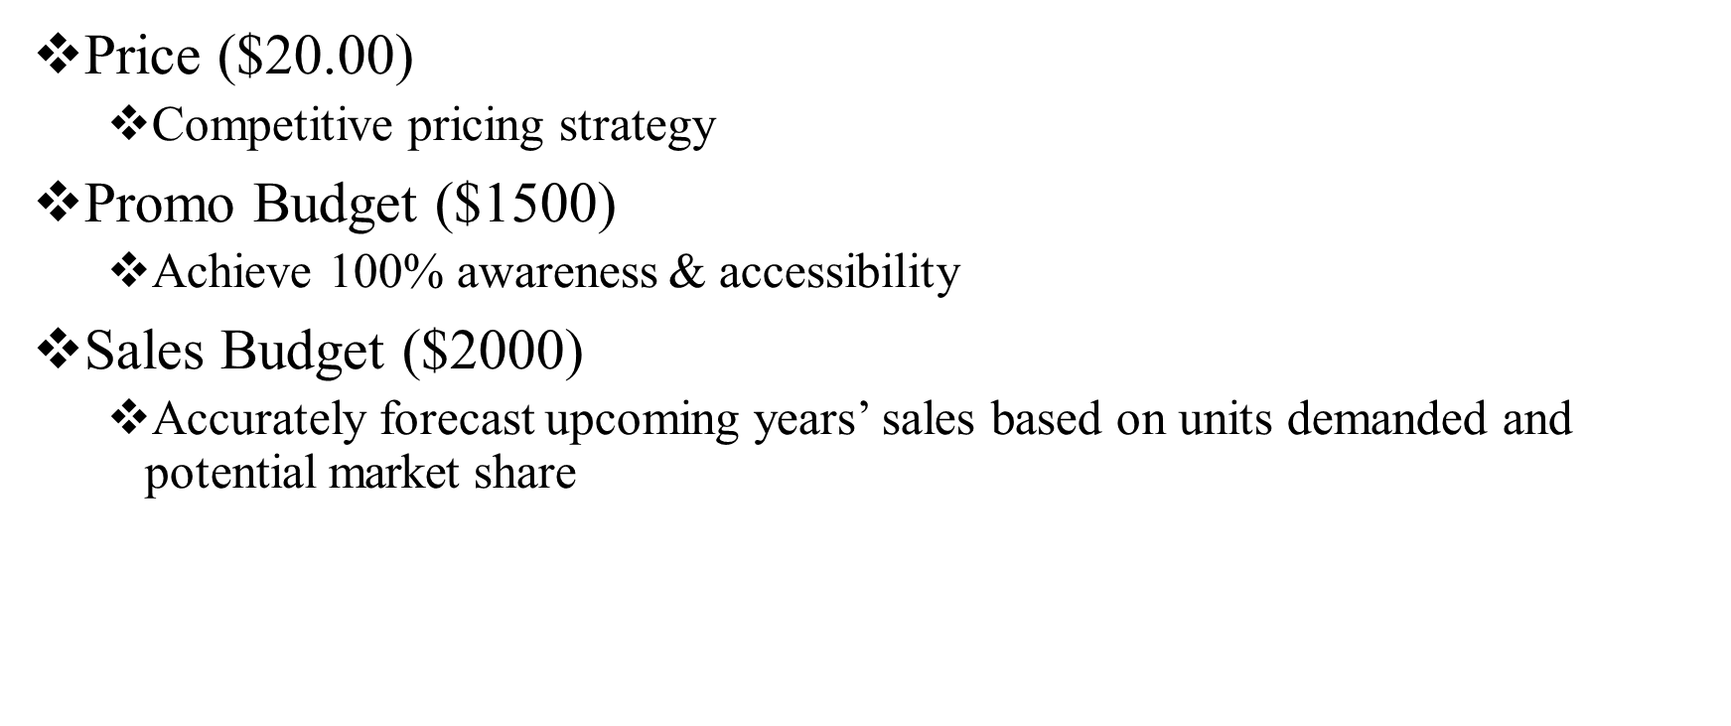
Notes:
Marketing
For Bead, price is the most important at 53%. According to the Capstone Team Member Guide prices drop by $0.50 per year. Bead’s price range would be $14.50-$20.50 for the upcoming year so I dropped the price to $20.00. Low-end customers want lower prices and well proven products. I wanted to set the prices lowest we could afford without going below our contribution margin or sacrificing demand. I set the promo budget to $1500 and the sales budget to $2000 to increase awareness (35% + 33%= 68%) and accessibility and not have any diminishing returns.
Your forecast for bead was set to 1801. 8960 x 1.117= 10,008 x .18=1801

Slide 4
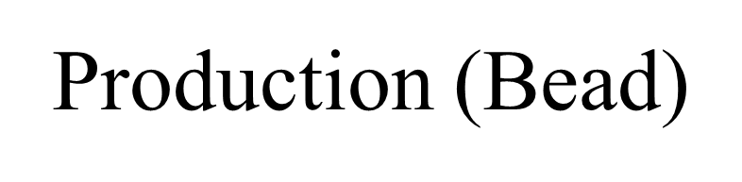
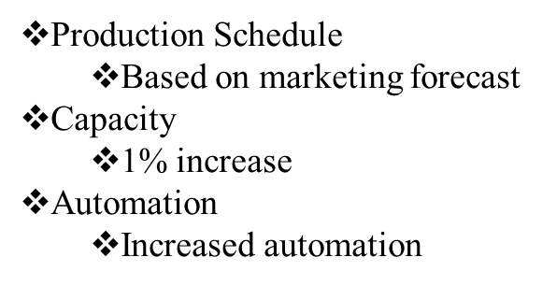
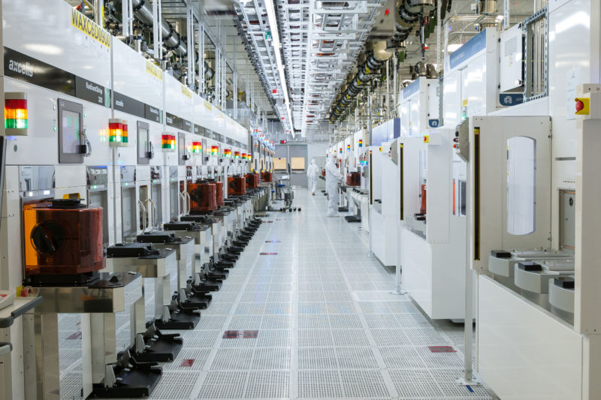
Notes:
Production
Production schedule was set at 1779 to get production after adj. to 1762.
I increased buy/sell capacity by 1%. I increased buy/sell capacity by 1%. (1400 x 0.01=14). I felt by buying capacity it would allow flexibility to deal with short term market changes.
I increased automation to 5.5 to help lower labor cost.

Slide 5
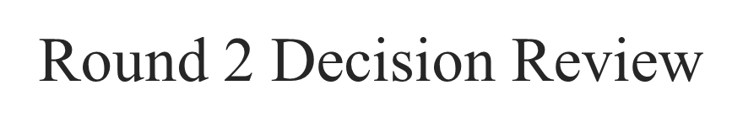
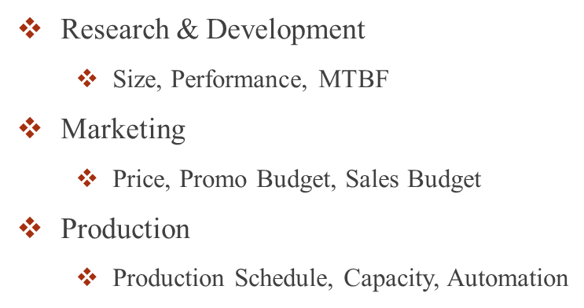
Notes:
R&D
In this Round, I decided to increase performance to 4.1, decreased size to 16, and decrease MTBF to 12000. I know the low-end customer want slower performance and bigger size in an attempt to move Bead to ideal position on perceptual map.
Marketing
I lowered all prices down by $1.00 to keep up with customer expectation.
For Promotion, I increased to $2000 to continue to help reach 100% awareness.
For Sales, I continue $2000 until we reach 100% accessibility.
Production
Production schedule was set at 1789 but was increased to 2000 because I had stock out in the last round and wanted to prevent this in the next round.
I did not buy/sell capacity in this round.
I increased automation to 6.4 in this round to continue to help lower labor cost.

Slide 6
Research and Development (Baker)
Notes:
In research and development this is our first that into being able to create the best product that we can in order to capitalize on the market that we are in. Looking at the research and development for Baker. I found that to 6.6 Pfmn and changed the size to 12.5. In this round I increased the Pfmn and decreased the size then what the consumer was looking for with a small increase in price. I do think that it is important to make sure that we are able to stay on top of our game in this sector for the industry. With the decisions that are made in the research and development is what will help set the tone. For this product segment for the year on helping to ensure that we have a profitable segment. This will help to make sure that the baker product will sell and sell more product then last year.

Slide 7
Marketing (Baker)
Notes:
Marketing is one of the most crucial parts Anixter research and development on getting the product to market. By being able to make sure that the promote and sells budgets and being able to increase our gross revenue. Due to how much we promote and are sales budgets are important to insuring that we are able to sale the forecasted amount. I do think that we can gain more on the product market percentage by increasing the promo and sales budget to help insure that all of the product will be sold.
For baker I increased the price of this product to $33 and set the promo and sales budgets at $2750 and my forecast to 1350. This means that the gross revenue will be at $44500 with a variable costs of $26288 and this will give me a contrib. margin of $18262 and less promo/sales of $12762.

Slide 8
Production (Baker)
Notes:
Now in production this is where it can make and break a company. I say that because if we under produce or overproduce then will not be able to me are cells forecast. Or will produce too much product where we cannot get rid of all the product by the end of the year. At the end of the day we have to make sure that we are able to sell what we produce and keep the contribution margin below 45% so that the company is able to maximize profits.
For this round I matched the production schedule with the unit sales forecast. Left Buy/Sell capacity at 0 and the new Autom. Rate at 4.0. By doing this it should allow this product segment to sell out of product and give the company great profit for this segment.

Slide 9
Baldwin’s Finances
Notes:
In the finance portion of this company this is where all the magic really happens in order to make sure that we have enough finances to continue our day to day operations. The decisions that are made in the finance a portion of the company or crucial to the company being able to stay operating setting when bills are to be paid and when consumers have to pay their bills. Along with issuing stock and being able to figure out how much money that we need to borrow in order to keep the company afloat for this makes financial year.
For this round we choice to issue the max on stocks. With nothing in retire stock or dividends for this round. We also choice to borrow just $9000 and retire no long term debt. As well as issuing $9000 in long term debt. Finally we set the A/R lag and A/P lag at 25 days. By doing this it has also increased how many days of working capital that we have and in the long run we will be able to pay off all of our debt and still have more then 90 days of working capital.

Slide 10
BALDWIN’S FINAL ANALYSIS
Notes:
As previously stated, Baldwin strives to continue our positive progress into the next round by continually decreasing our cash outflow and increasing our cash inflow. We believe during this next round, the company will be stable enough to begin to pay back some of our debt and lower our overall product costs. We also believe we will be able to issue dividends to our stockholders and bonuses to our employees. Our overall goal is to not only beat the competition but to expand the company. We feel we can do this by becoming more aggressive in round 2 in order to increase profits and the amount of market share that the company holds in this industry. We feel we can beat out the competition by swaying their customers to buy our products not only because they are superior but because we can offer them at a better price and a better MTBF.

Slide 11
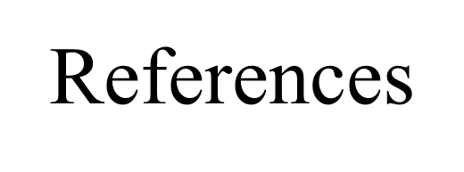
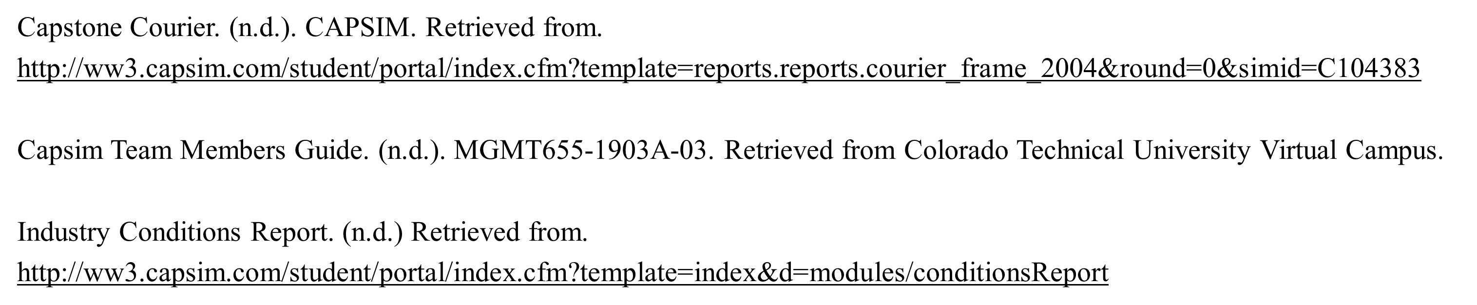
“Research and Development.” (2016).
Retrieved from: http://ww3.capsim.com/modules/
GIA/files/2016C_0/0/Capstone/EN/PDF/RDDemo-Transcript(EN).pdf.
“Threat Of Substitutes | Porter’s Five Forces Model.” (2014).
Retrieved from: https://www.cleverism.com/threat-of-substitutes-porters-five-forces-model/.

